Slide 1


Slide 2
GLOBAL CNC PROIZVODNJA
CNC Machining Partner for Serial Production
Teslić, Bosnia and Herzegovina
globalcnc.co
Notes:
2

Slide 3

ABOUT US
We are a modern CNC machining company focused on
precision manufacturing and serial production.
Experienced team
Continuous investment in technology
Reliable and flexible production
We build long-term partnerships based on quality and trust.
Notes:
3

Slide 4
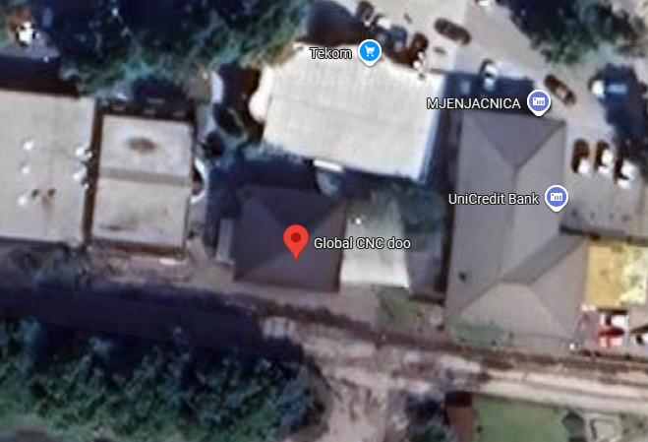
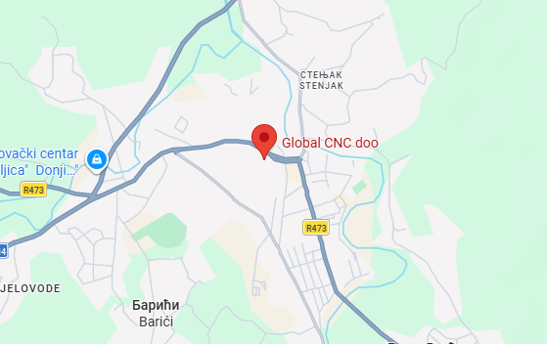
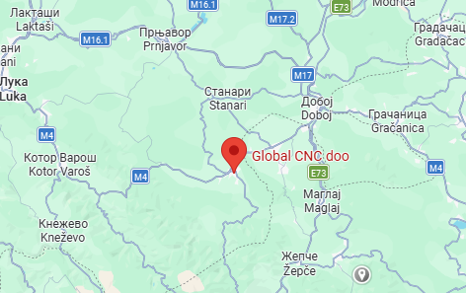
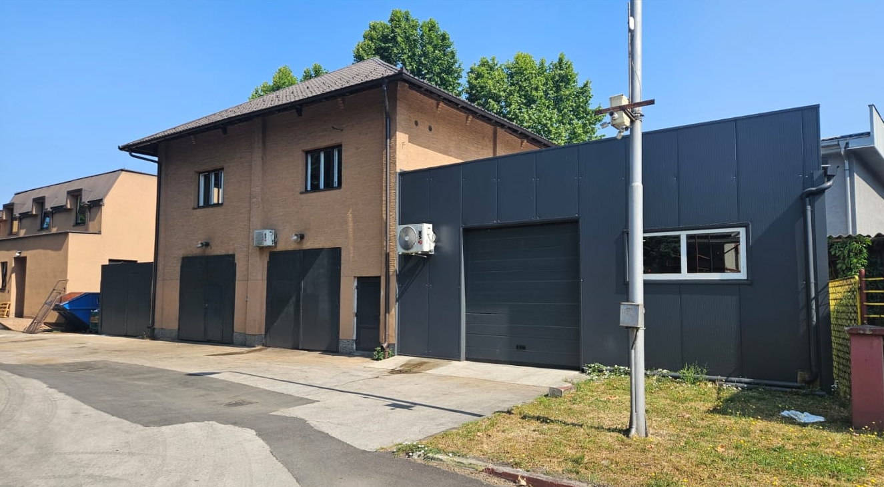
PRODUCTION FACILITY
Organized workflow
Efficient production layout
Ready for scalable operations
Notes:
4

Slide 5
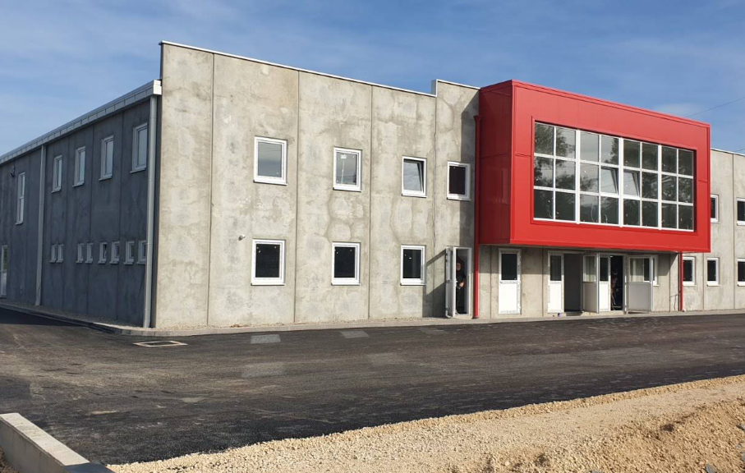
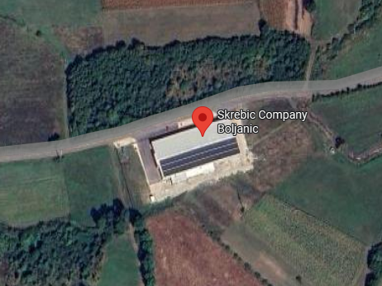
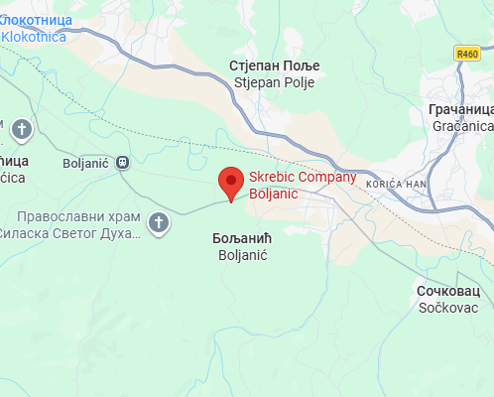
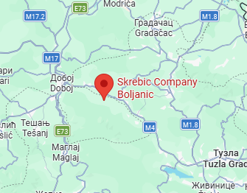
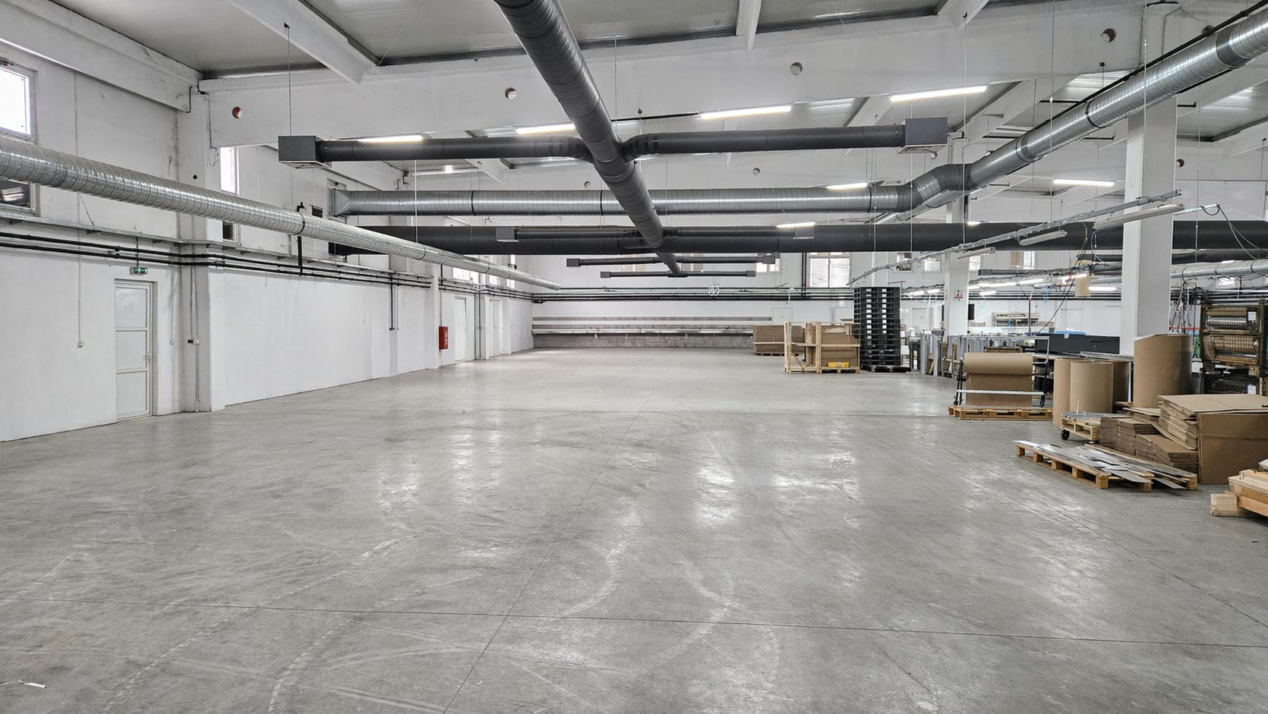
PRODUCTION FACILITY
Additional 1500 m² of floor space for future expansion
Large capacity production potential
Ready for immediate machine installation
Notes:
5

Slide 6
BOLTS (BOLZEN) SERIAL PRODUCTION
Our journey in bolt manufacturing began in June 2025 by overcoming significant initial technical hurdles and refining complex processes. Through rigorous optimization and a commitment to quality, we have transformed those early challenges into a streamlined, high-precision operation that now delivers industry-leading standards and reliability.
Perfect surface finish
300-900 produced bolts per day depending on size
Precise quality control
Future increase of production
Notes:
6

Slide 7
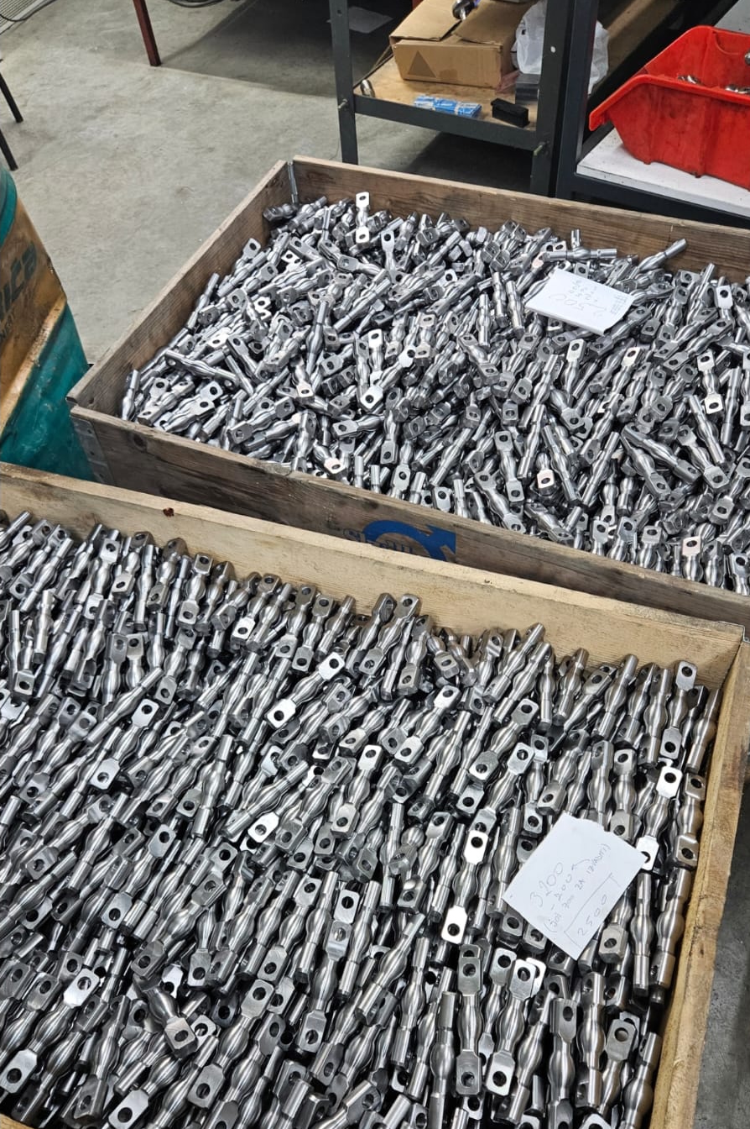
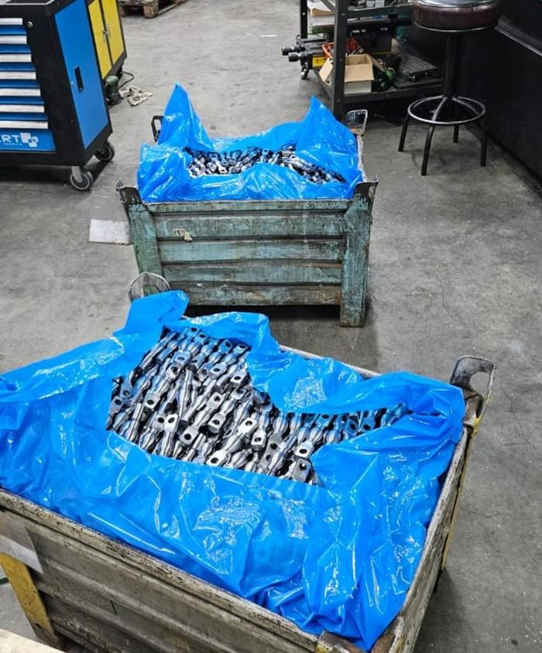
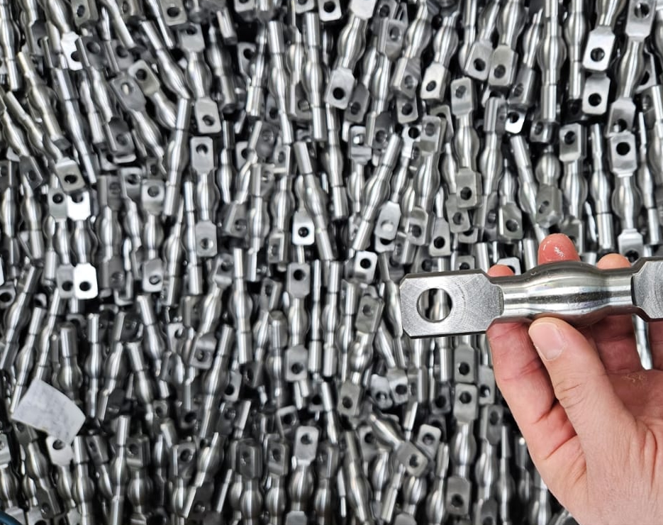
BOLTS (BOLZEN) SERIAL PRODUCTION
Large batch capacity
Stable production
Reliable delivery
Notes:
7

Slide 8
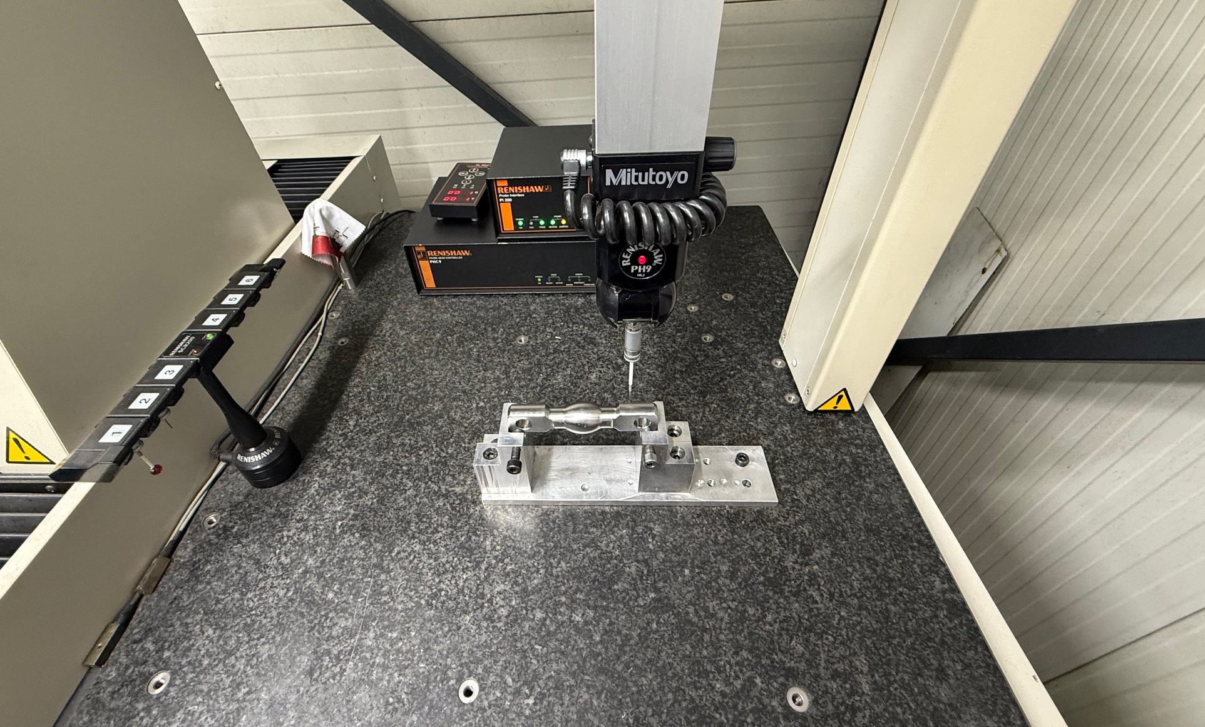
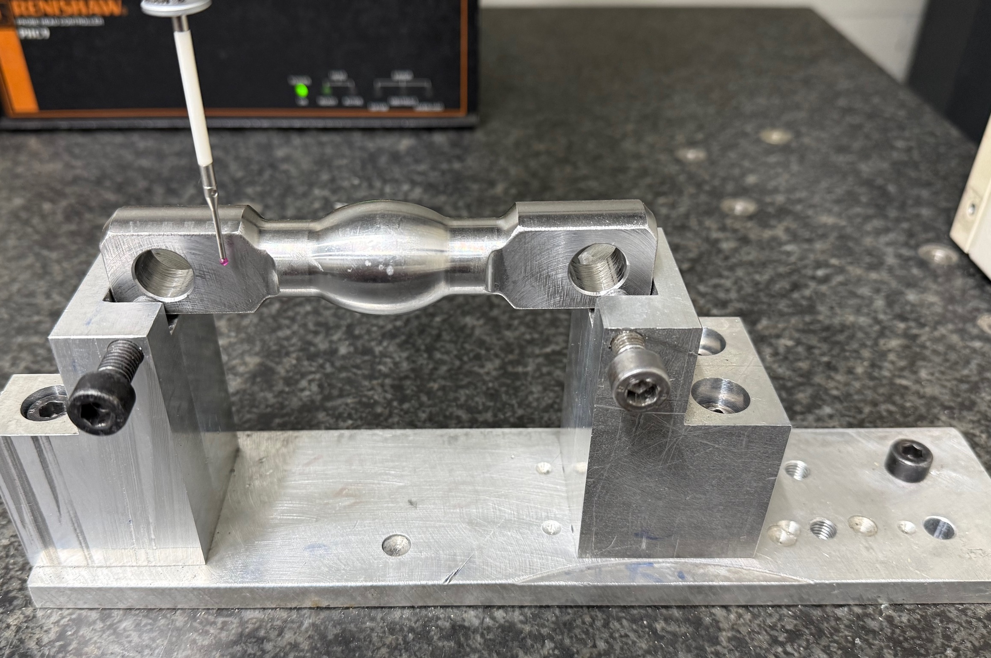
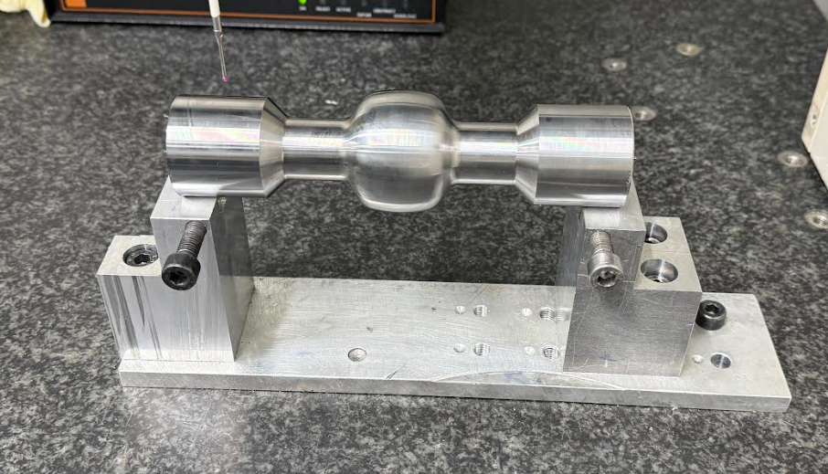
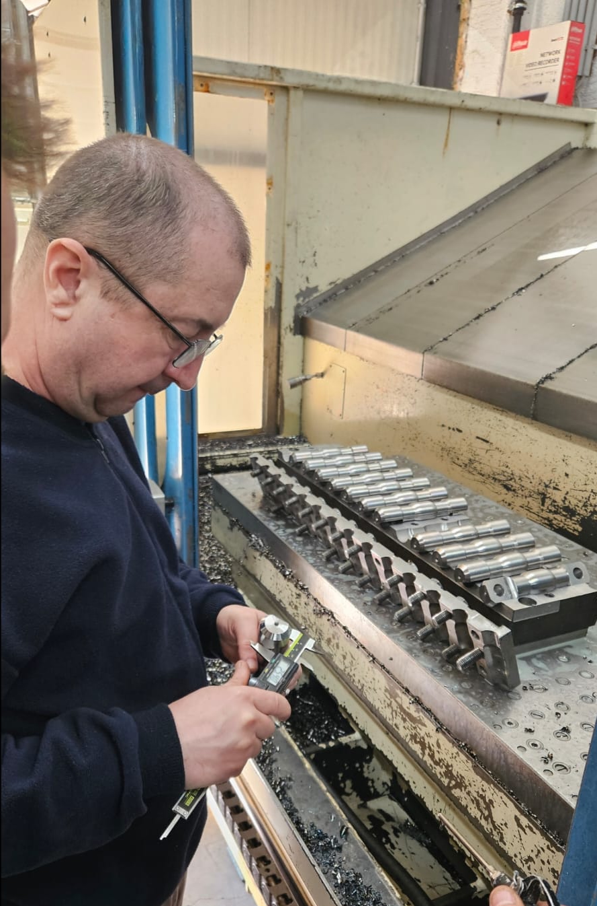
QUALITY CONTROL
Quality control in every step
In-process inspection
Dimensional accuracy
Consistent results
Notes:
8

Slide 9
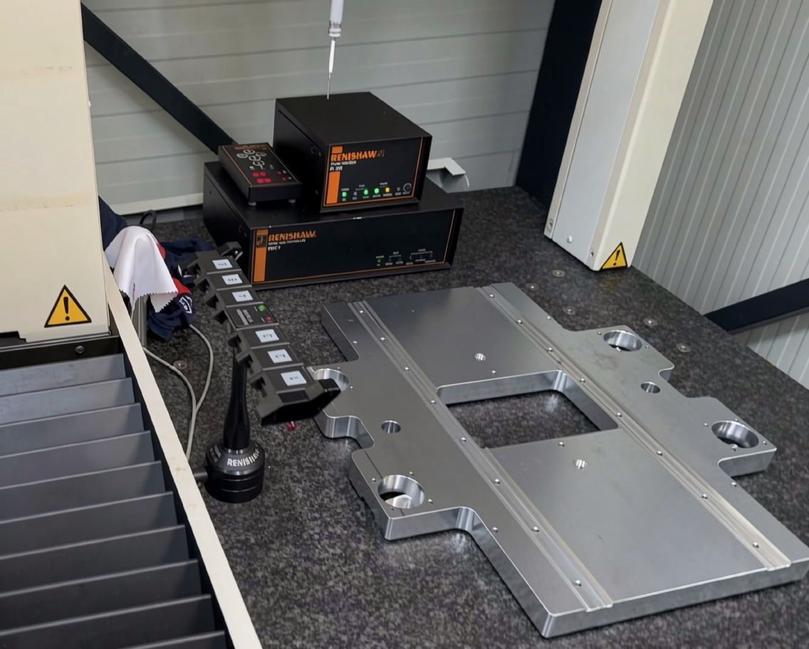
PRECISION MACHINING
Precision machining & surface quality
Tight tolerances
Clean finish
Attention to detail
Notes:
9

Slide 10
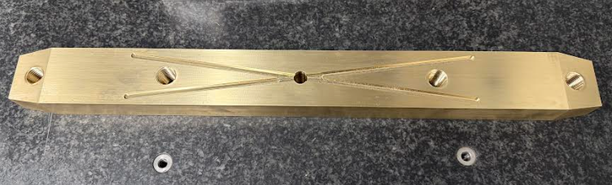
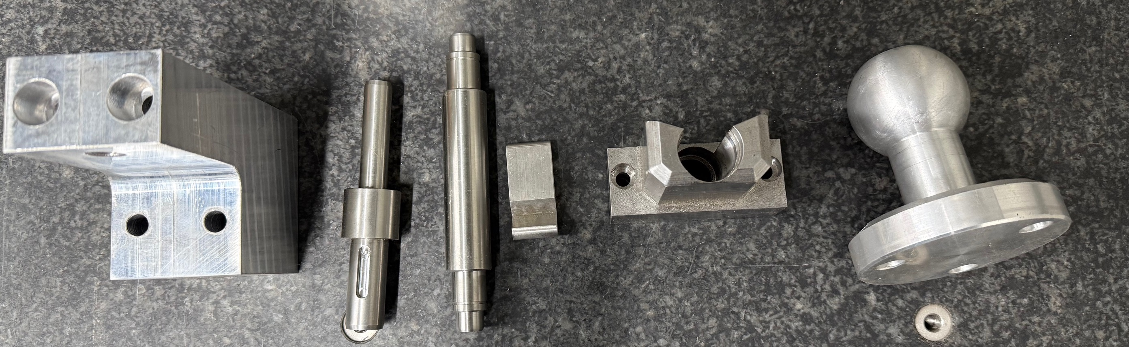
PRODUCT RANGE
Long-term clients:
Promot Automation
SIGMA Laser
Ergosana
I2Trade
Magro
And more
Notes:
10

Slide 11
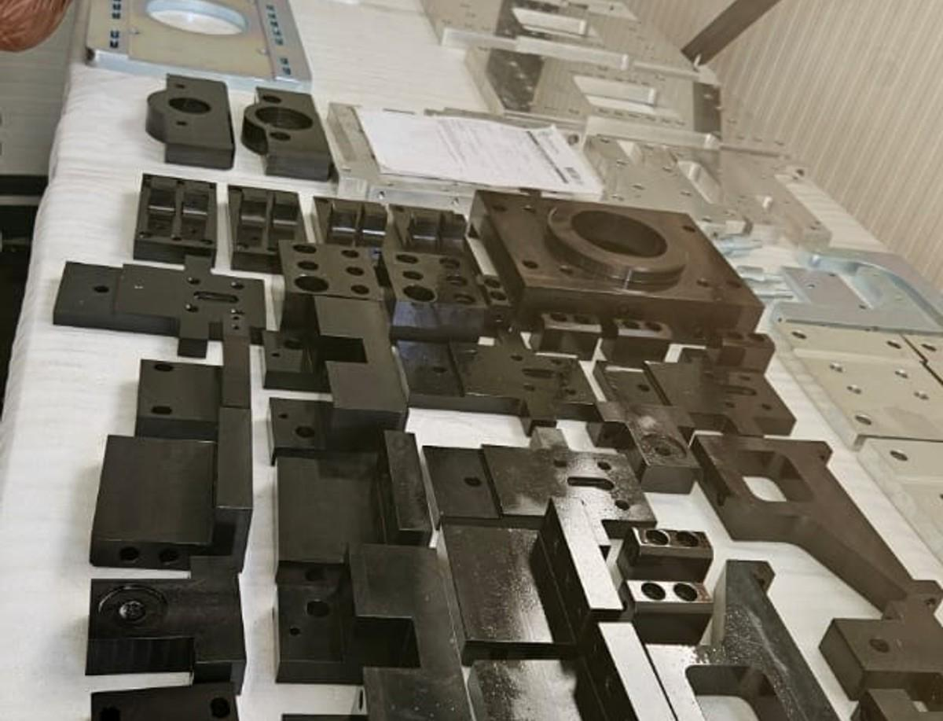
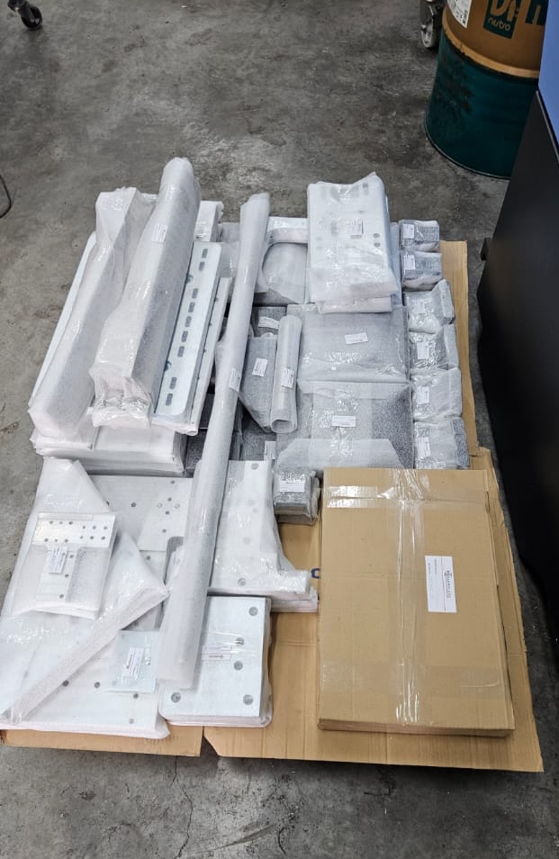
PRODUCT RANGE
Applications Across Industries:
Railway applications
Automation machinery parts
Clamping parts
Opportunities for military industry parts production
And many others
Notes:
11

Slide 12
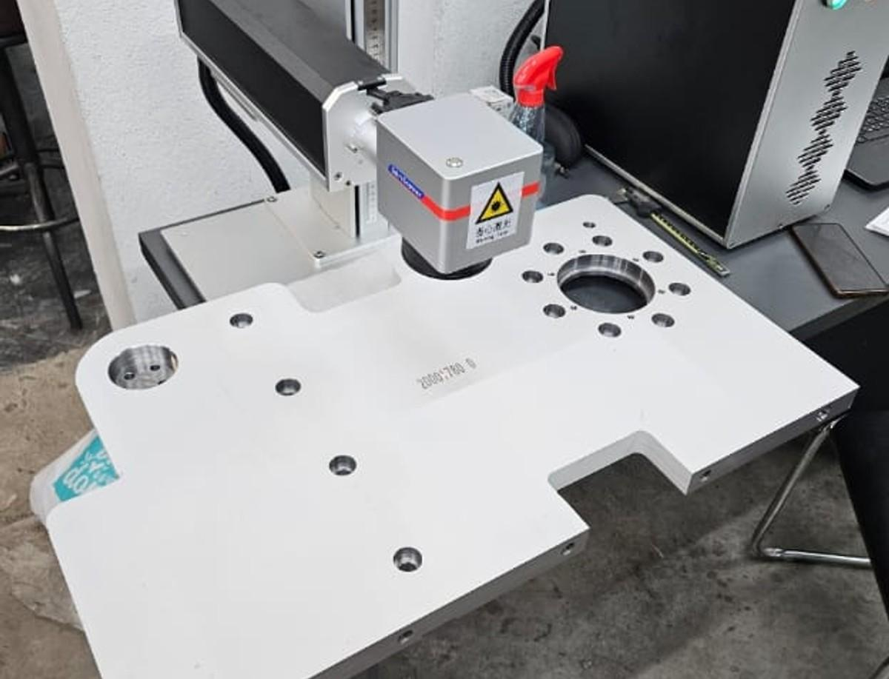
LASER MARKING & ENGRAVING
Permanent part marking
Serial numbers & logos
High precision and clarity
Traceability support
Notes:
12

Slide 13
CURRENT PRODUCTION CAPACITY
4,080
5,100
3200+
minutes/day
minutes/day
hours/month
CNC Milling
CNC Turning
Machining Time
Our production is flexible and scalable — we are ready to increase capacity and adapt quickly to meet growing project demands.
Notes:
13

Slide 14
CURRENT PRODUCTION CAPACITY
1,200
900
700
400
Bolts/day
Bolts/day
Bolts/day
Bolts/day
CNC turning
For diameter
less than ⌀45
CNC turning
For diameter
greater than ⌀45
CNC Turning and Milling for diameter less than ⌀45
CNC Turning and Milling for diameter greater than ⌀45
Notes:
14

Slide 15
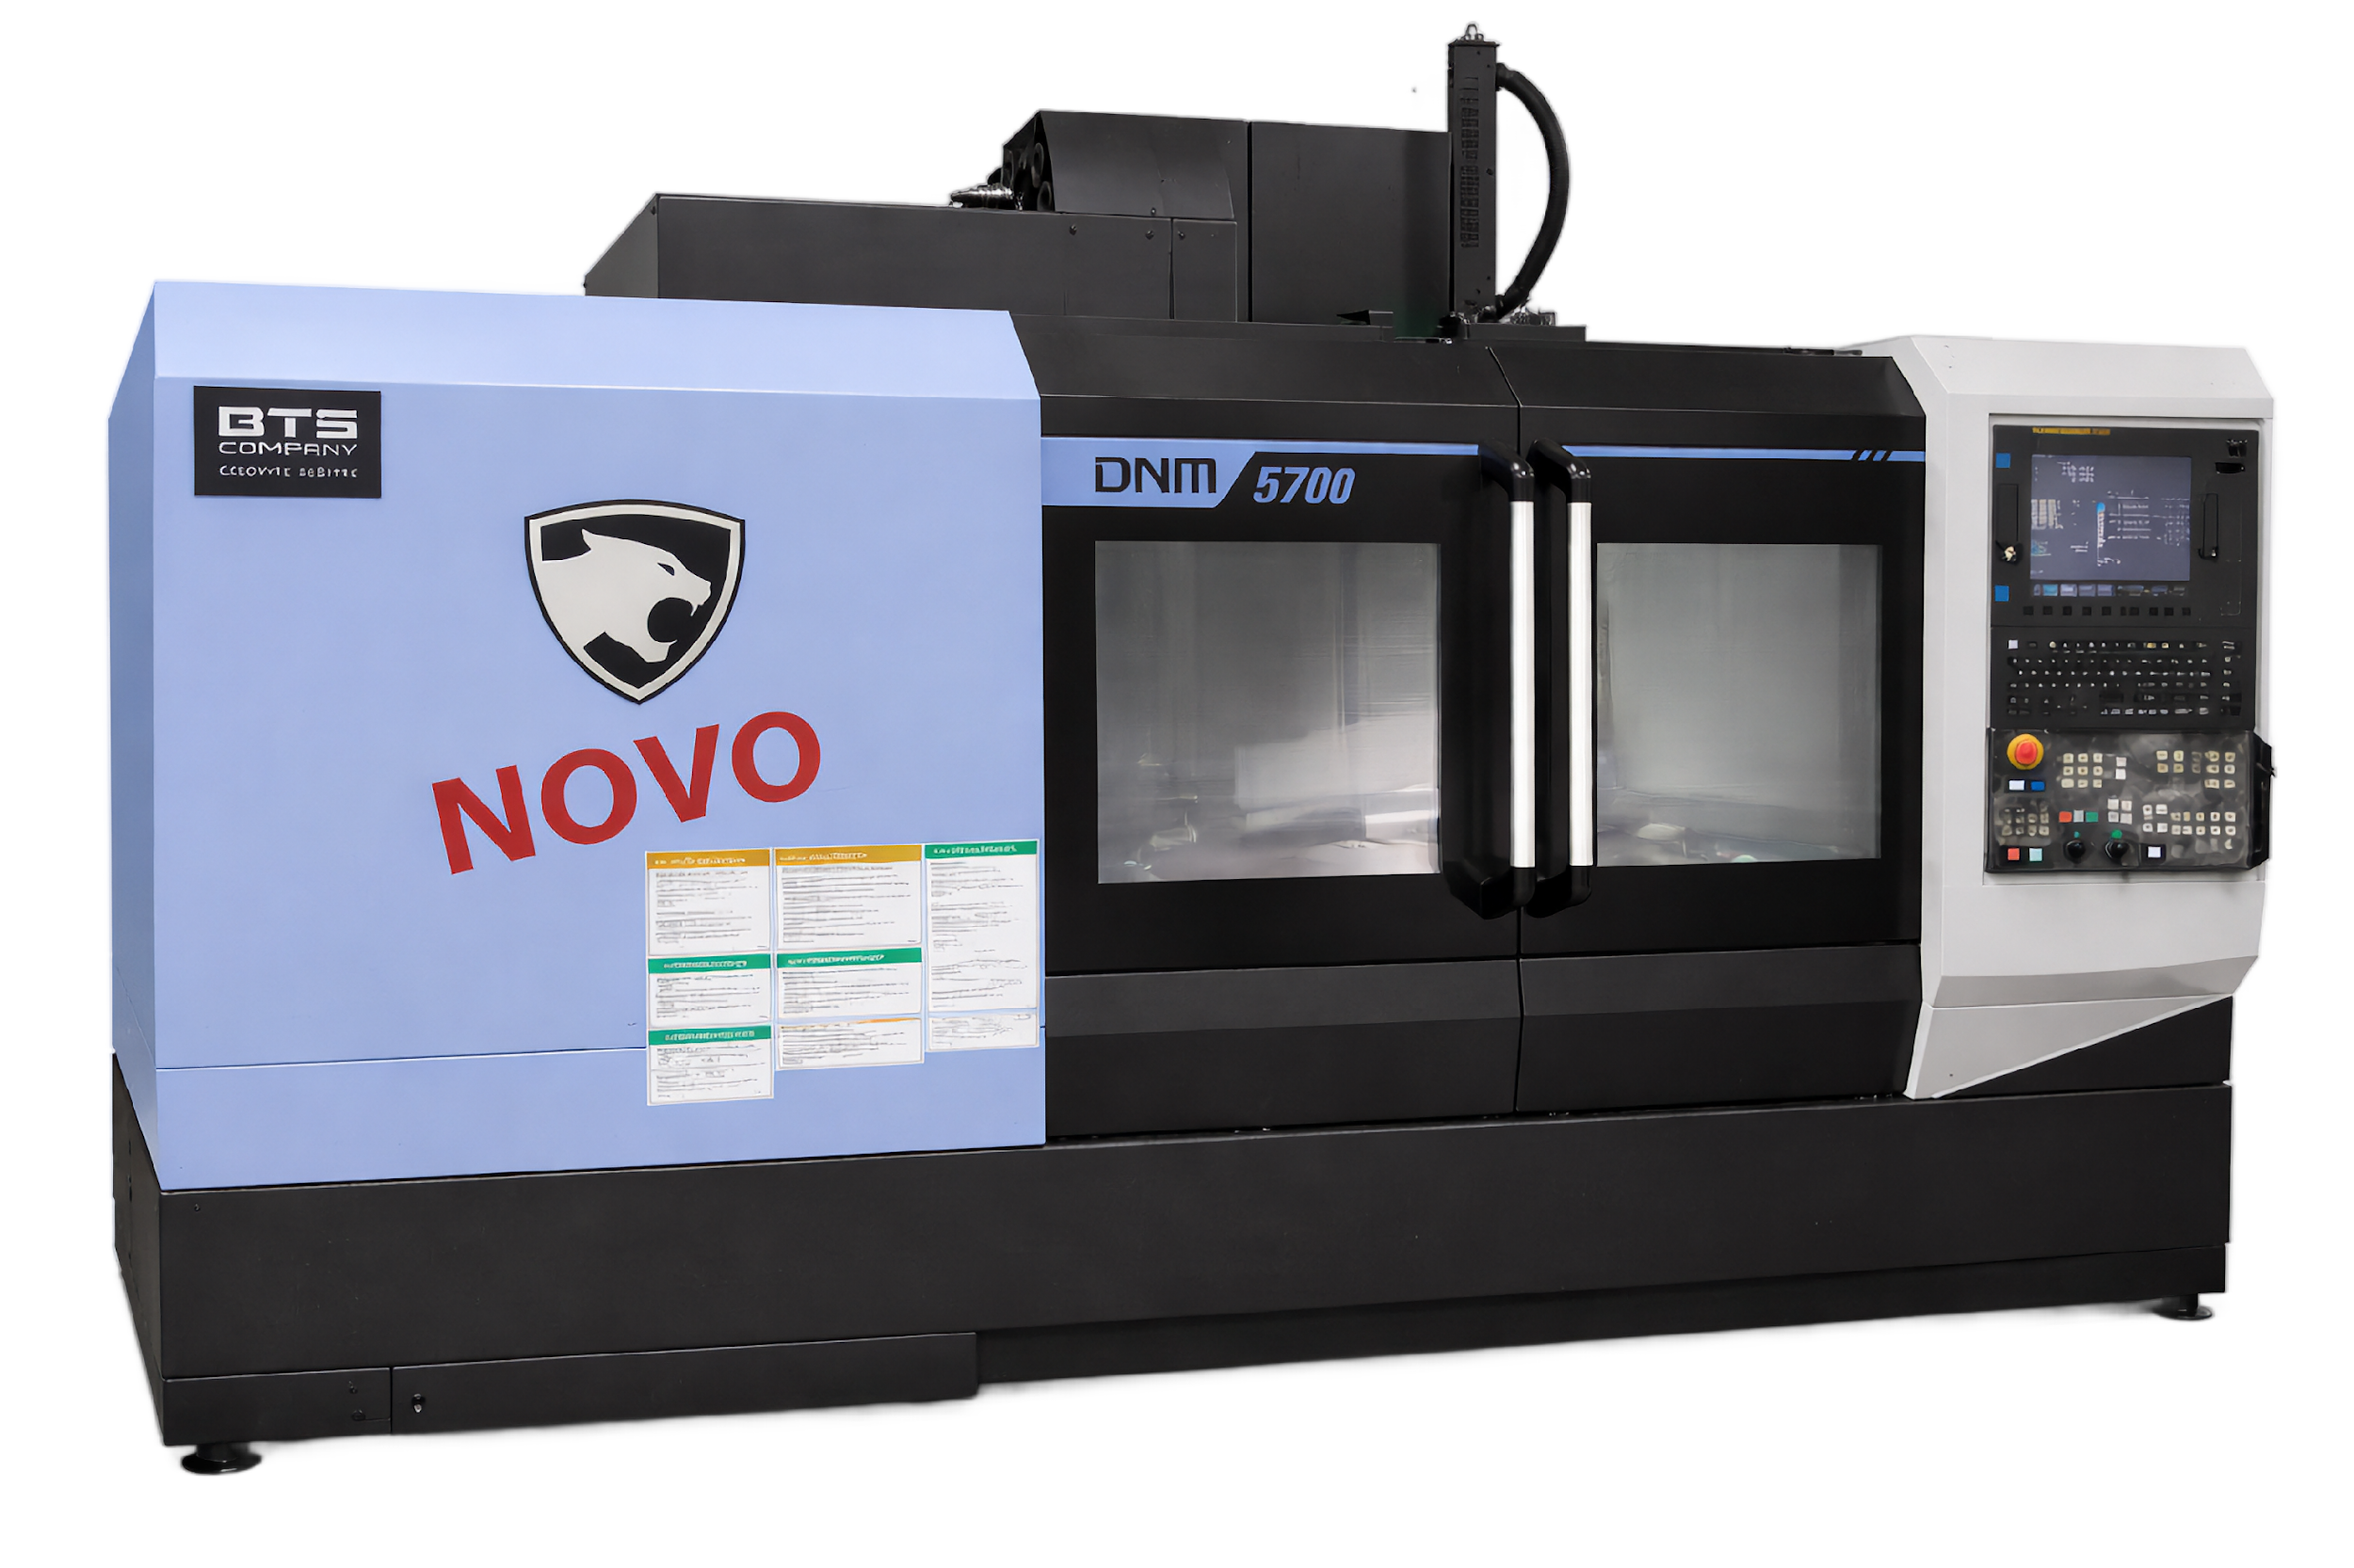
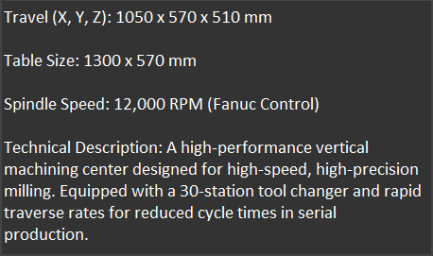

OUR MACHINES
Doosan DNM 5700
3-Axis CNC Milling
Notes:
15

Slide 16
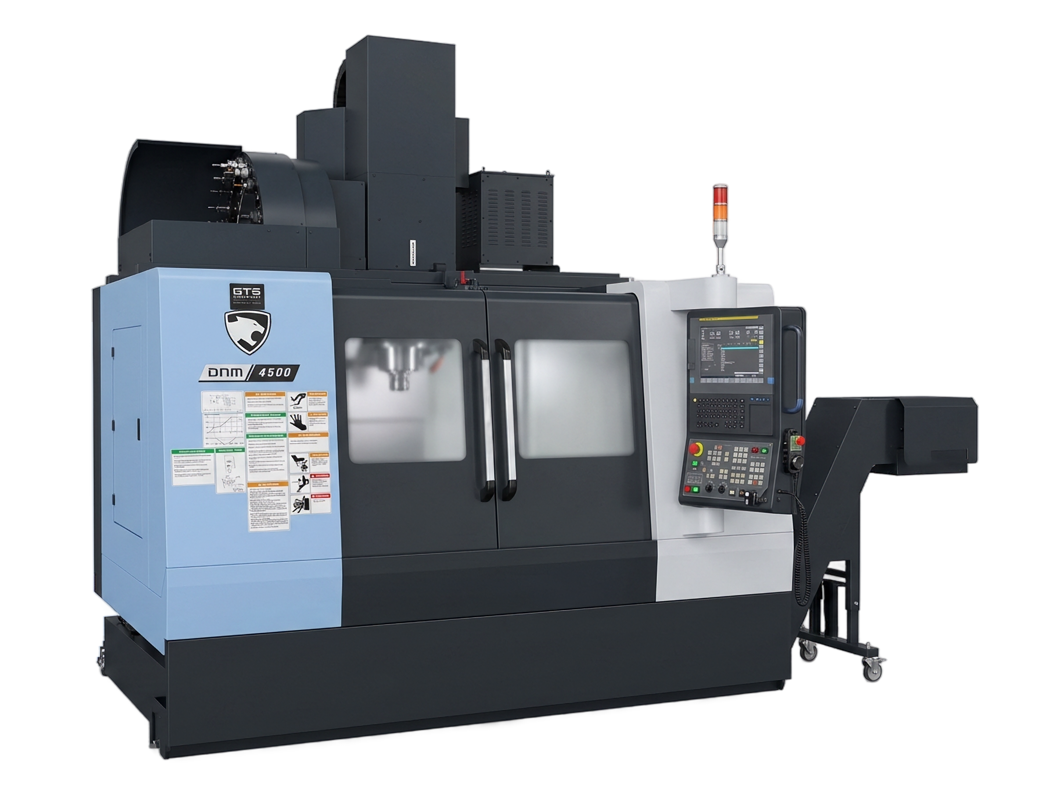
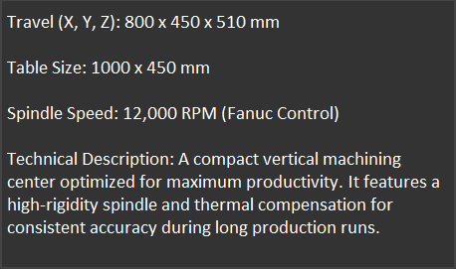
OUR MACHINES
Doosan DNM 4500
3-Axis CNC Milling
Notes:
16

Slide 17
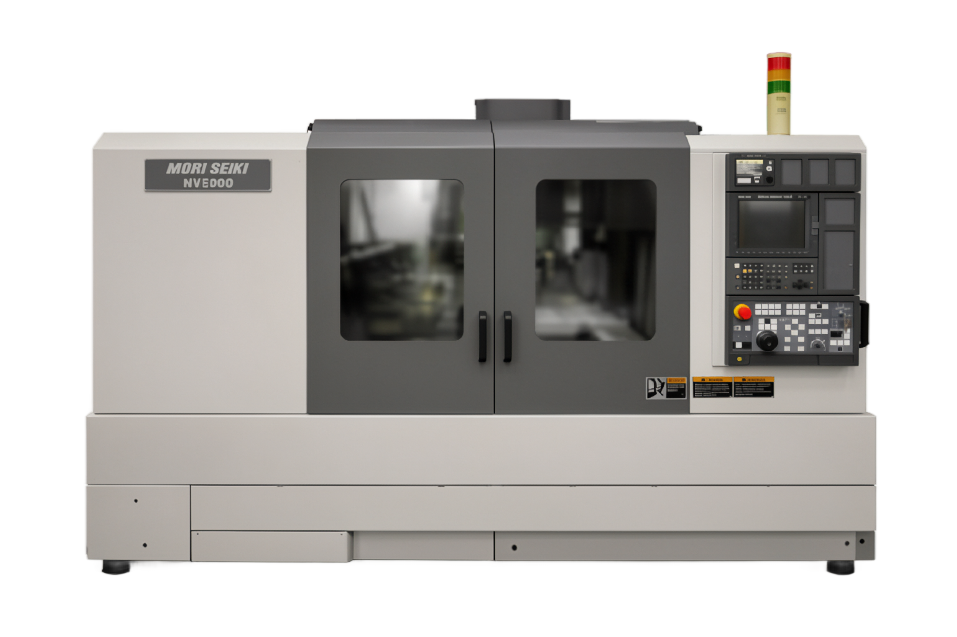
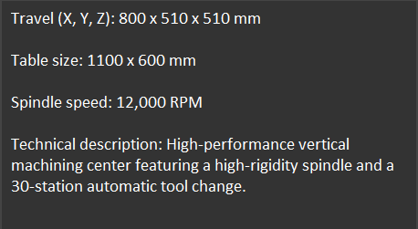

OUR MACHINES
Mori Seiki NV5000
3-Axis CNC Milling
Notes:
17

Slide 18
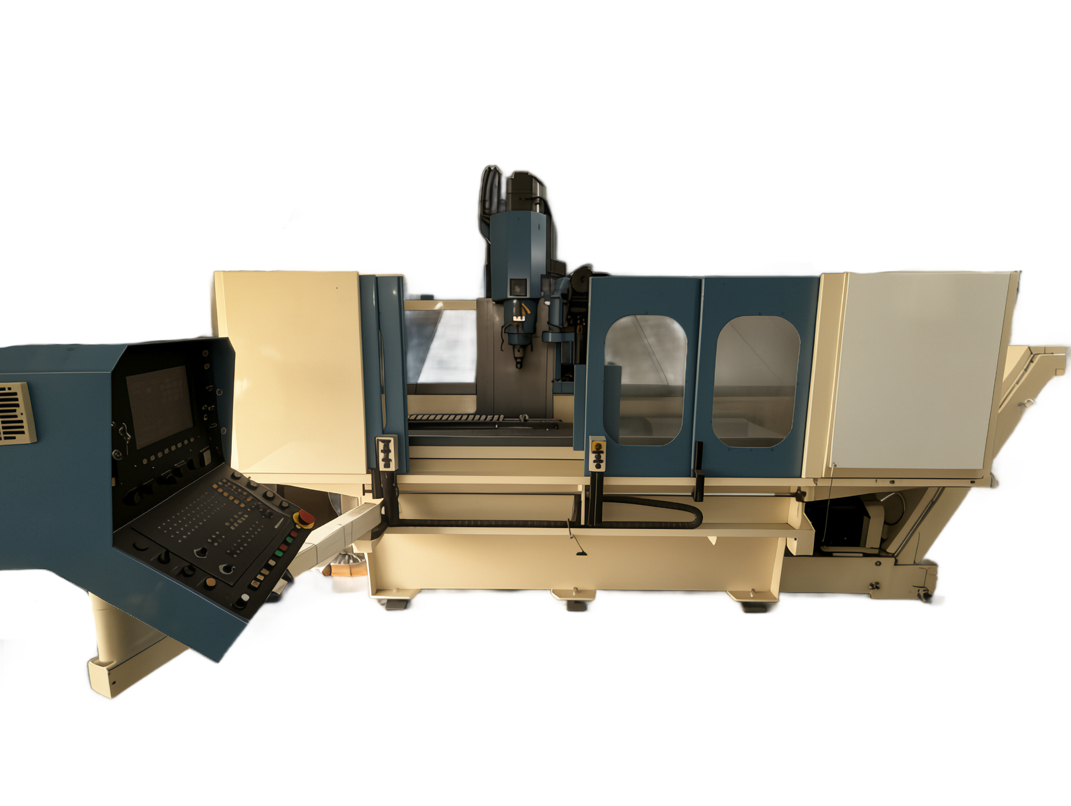
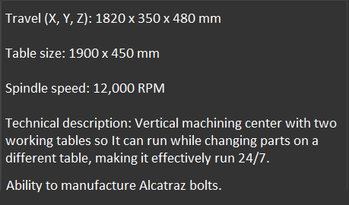

OUR MACHINES
AXA VSC 1-M
3-Axis CNC Milling
Notes:
18

Slide 19
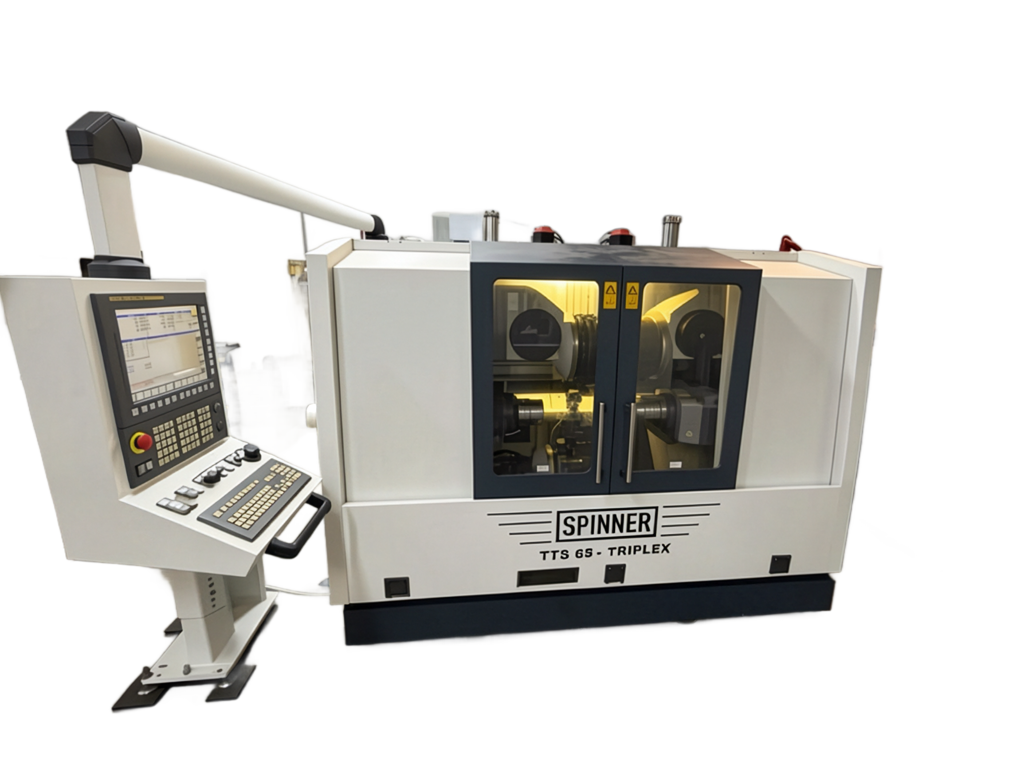
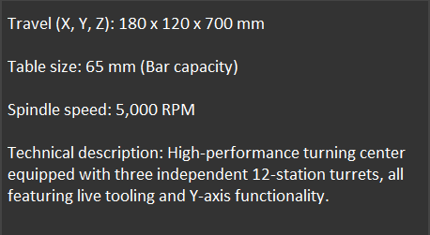

OUR MACHINES
SPINNER TTS 65 Triplex
Multi-Axis CNC Turning
Notes:
19

Slide 20
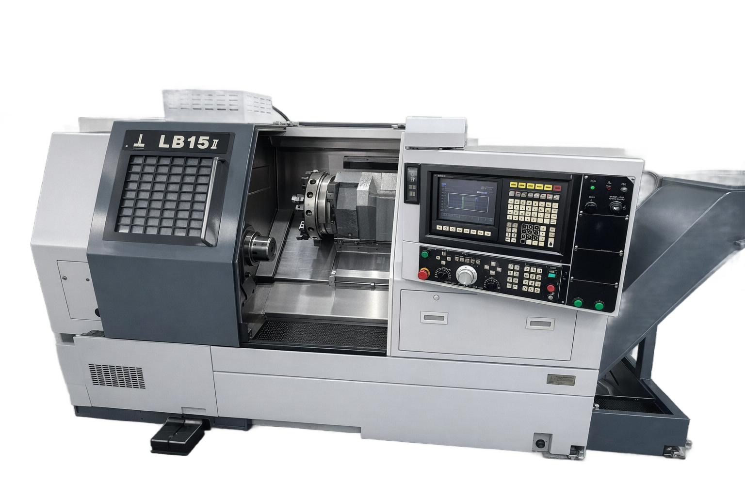
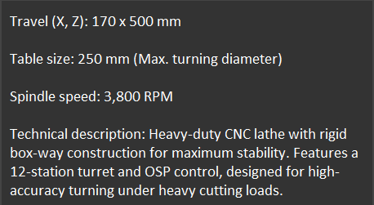

OUR MACHINES
Okuma LB15
CNC Turning
Notes:
20

Slide 21
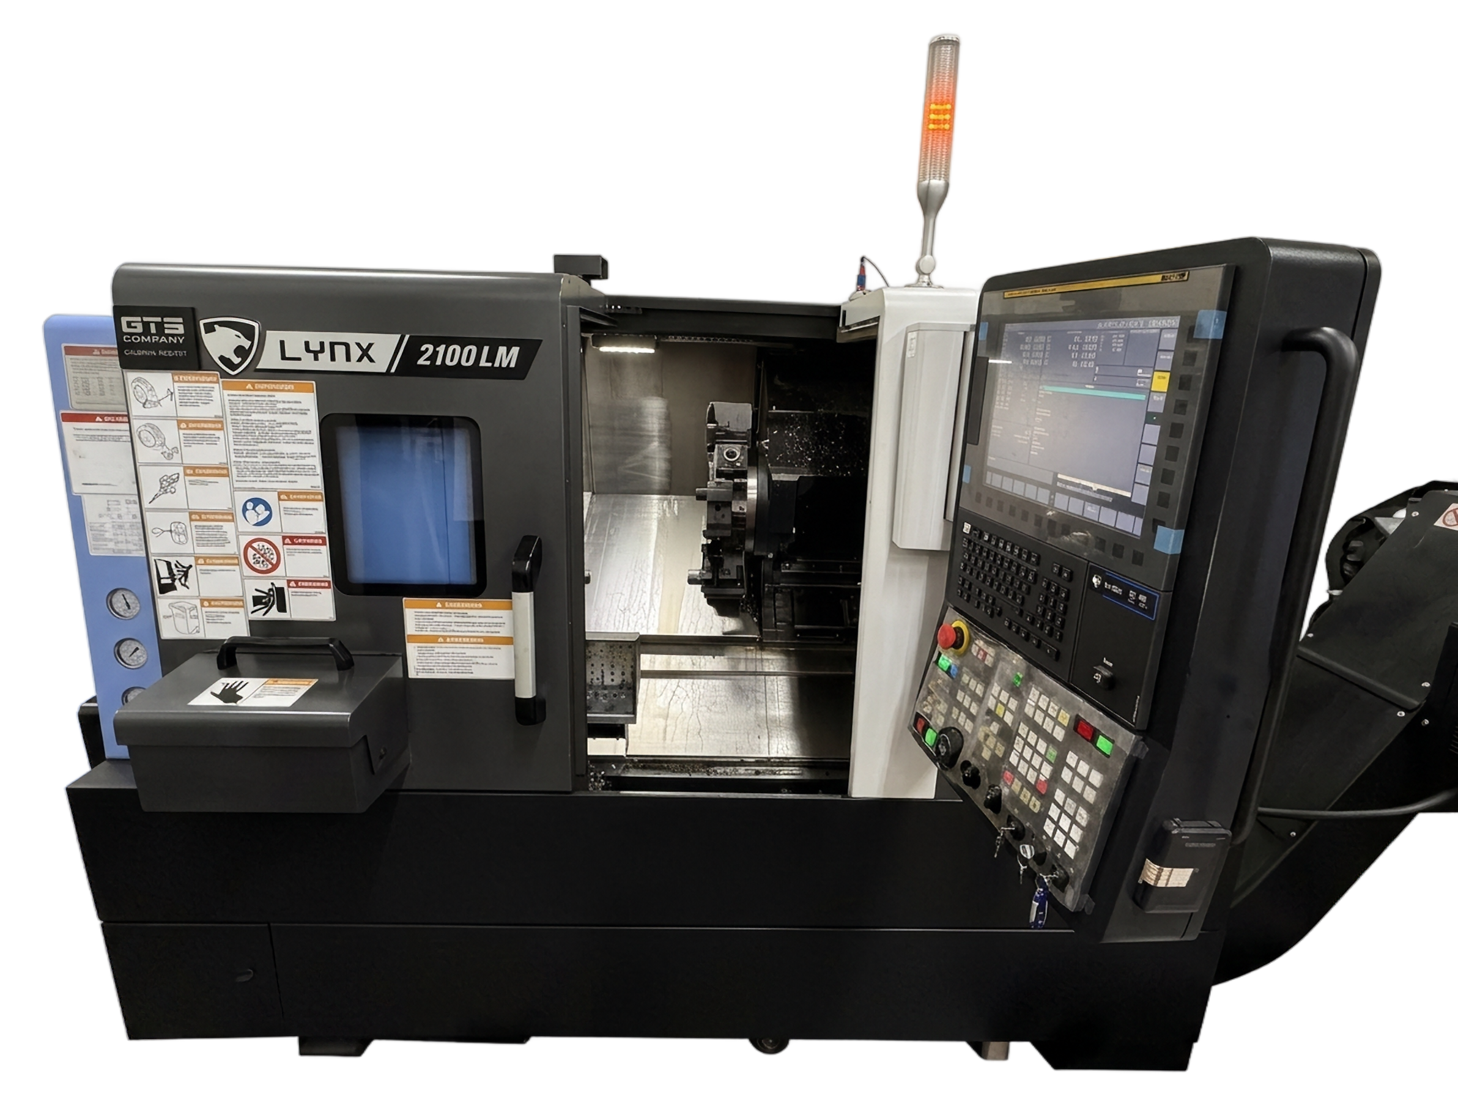
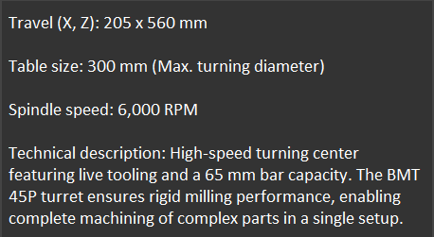
OUR MACHINES
Lynx 2100 LM
CNC Turning
Notes:
21

Slide 22
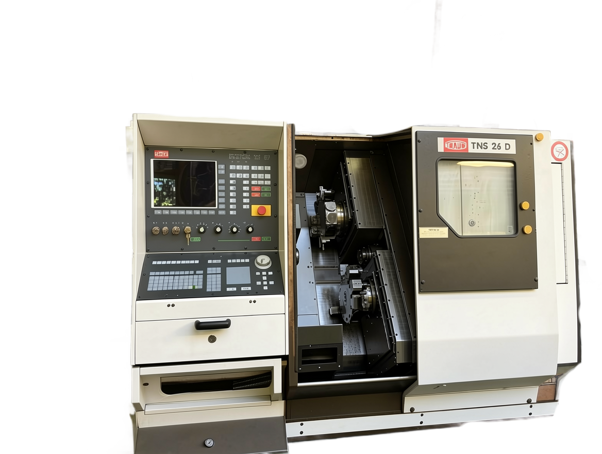
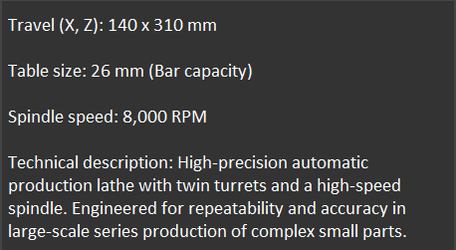

OUR MACHINES
TRAUB TNS 26 D
CNC Turning
Notes:
22

Slide 23
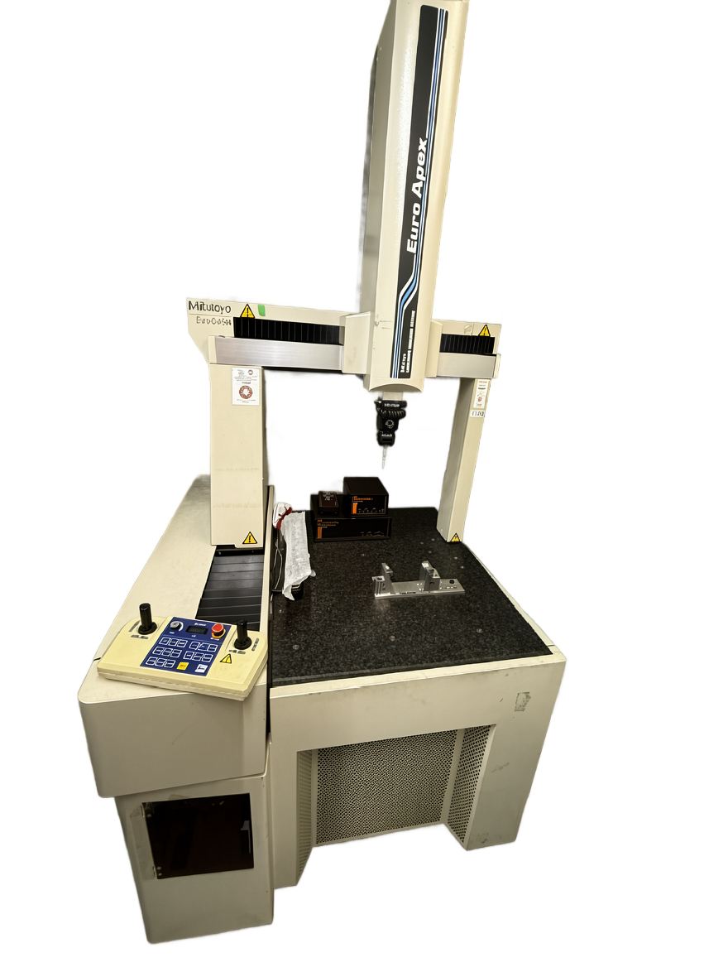
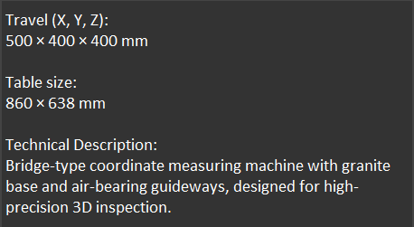

OUR MACHINES
Mitutoyo Crysta Apex
CMM Machine
Notes:
23

Slide 24
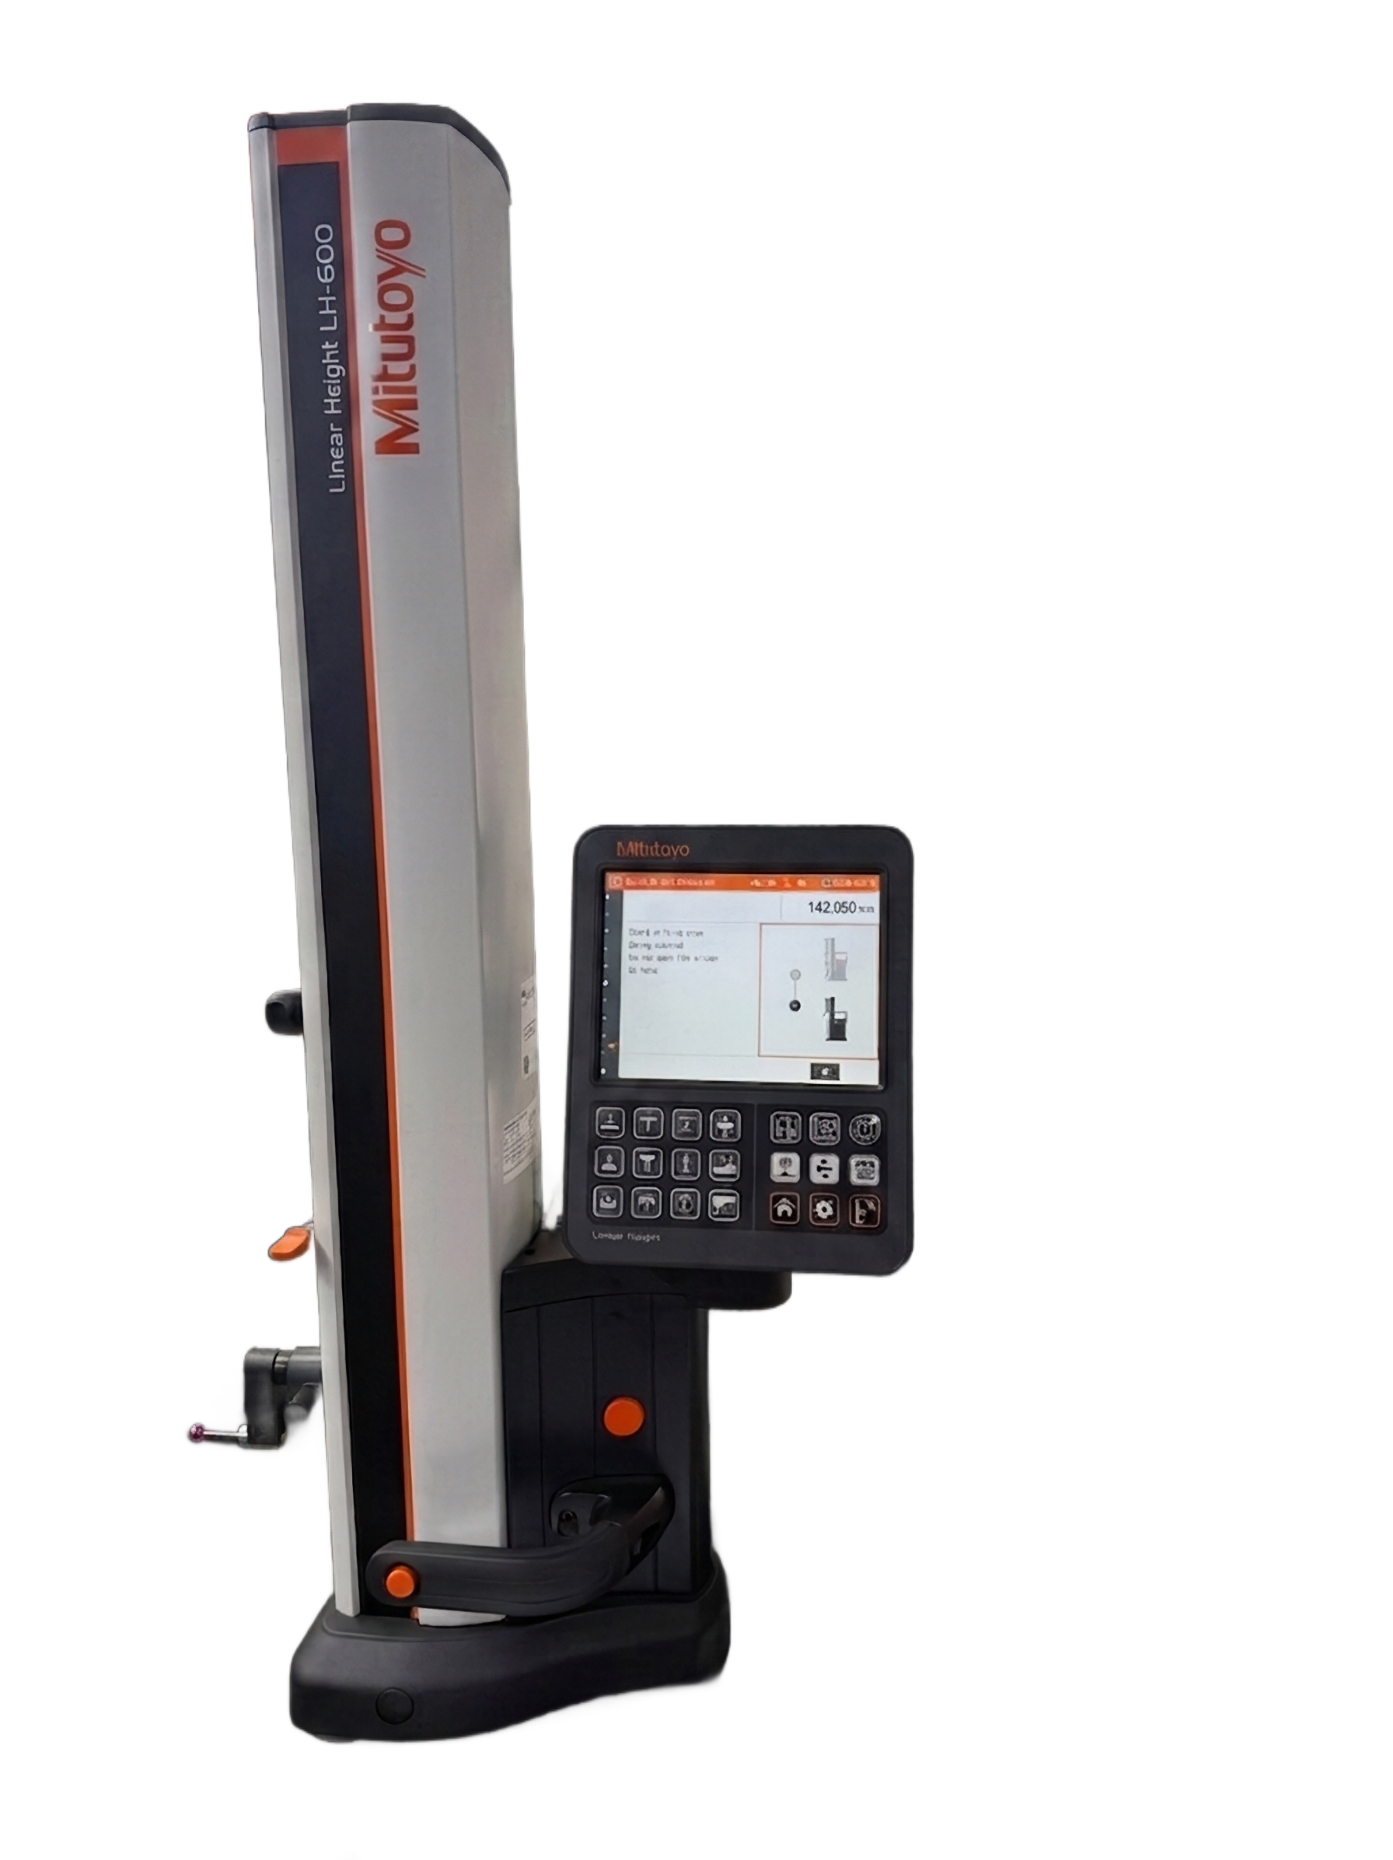
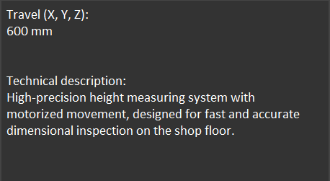

OUR MACHINES
Mitutoyo LH600
Linear Height Gauge
Notes:
24

Slide 25
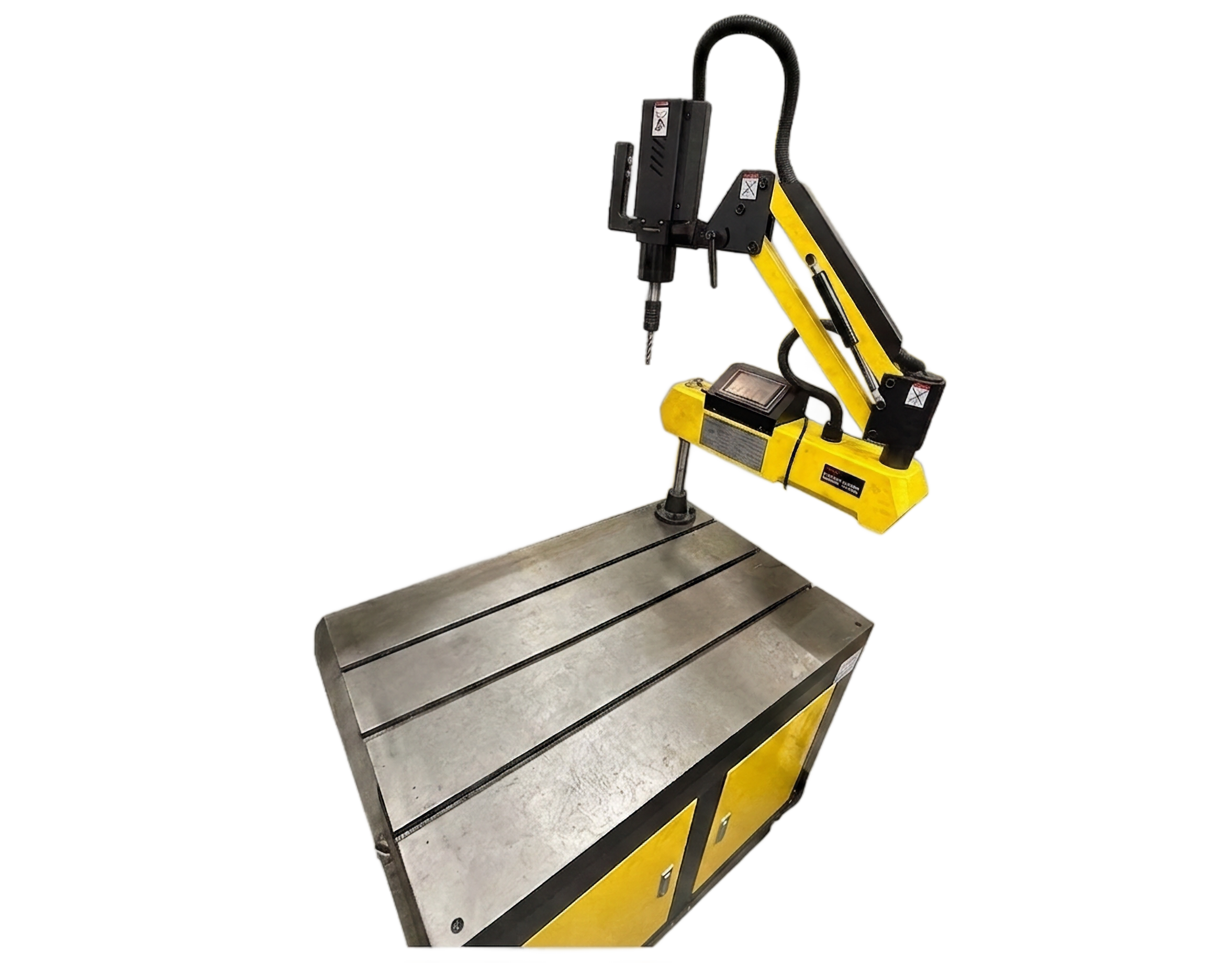
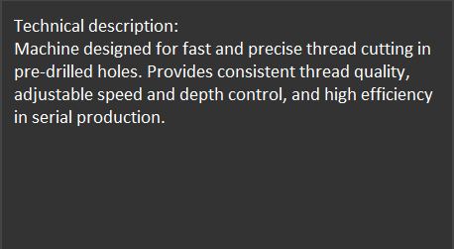
OUR MACHINES
Tapping Machine
Notes:
25

Slide 26
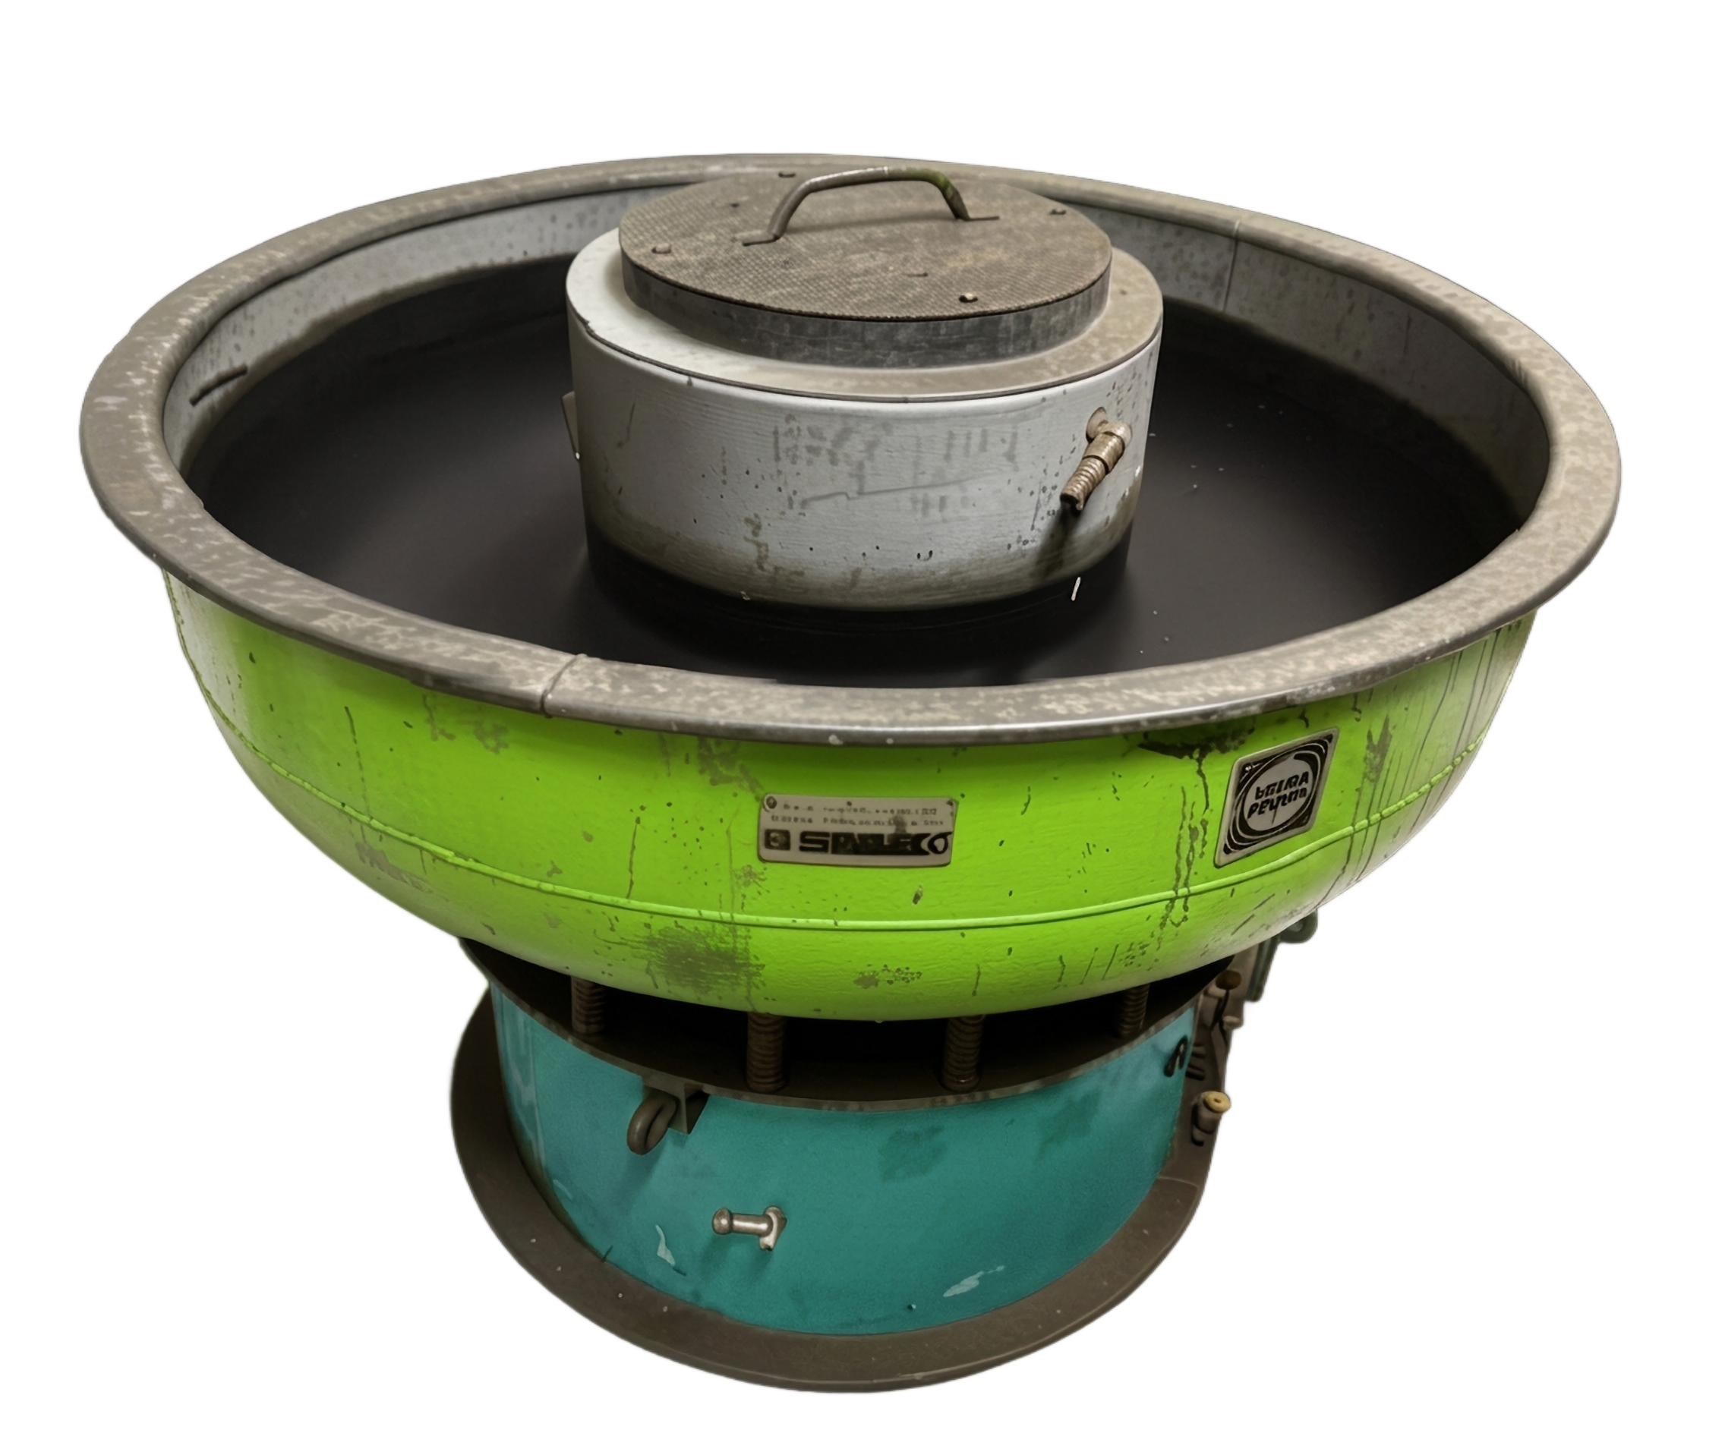
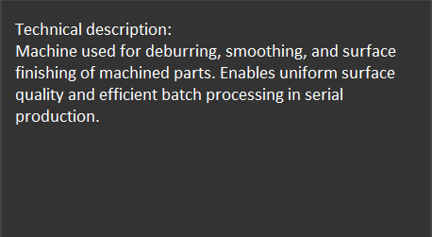
OUR MACHINES
Vibratory Polisher
Notes:
26

Slide 27
WHY CHOOSE US
Reliable partner
Continuous expanding and further growth potential
Competitive pricing
Long-term cooperation
Flexible production
Notes:
27

Slide 28
Notes:
28

